Slide 1
ITIL/ITSM and DevOps
with or versus?

Slide 2
What is ITIL?
Overall ITIL is still sequential, plan-centric, and deterministic set of detailed practices for IT service management. ITIL focused on “services” and describing “what you deliver”. ITIL concepts:
We should first analytically determine a service strategy and charter the service.
Create a detailed Service Design Package, and organize resources into development projects that are designed, executed and transitioned in a high-ceremony fashion to operations (as a discrete function).
And when that’s done, continual service improvement can start.
We ensure that everything is documented, and we assume that organizational resources are available and capable of generating and consuming this documentation.

Slide 3
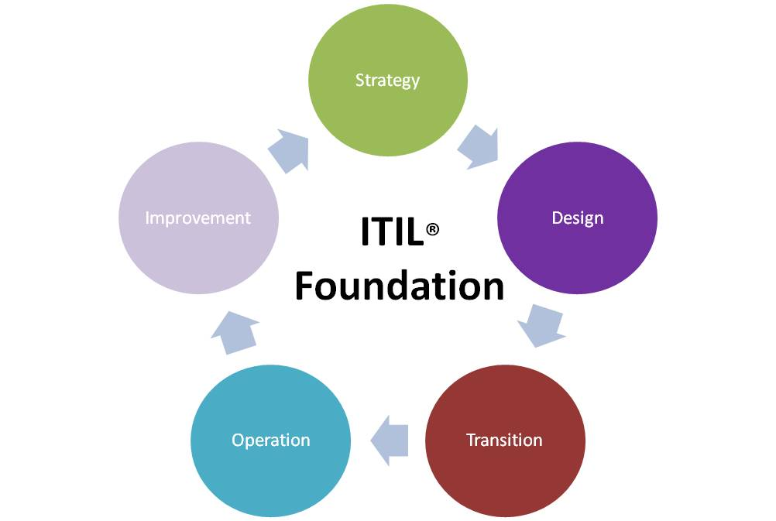
Service Management - a set of specialized organizational capabilities for providing value to customers in the form of a service.

Slide 4
Service lifecycle ITIL implementation
- service portfolio managment
- financial managment
- demand managment
- capacity managment
- service level managment
- availibility managment
- information security management
- service validation
- testing evaluation
- release and deployment managment
- configuration managment
- service asset
- event managment
- incident managment
- request managment
- access managment
- problem management
- non-stop improvements
Strategy
Design
Transition
Operations
Continuous Improvement

Slide 5
Difference in concepts ITIL DevOps
IT is a Service Provider
IT projects
PMO, Development, Ops -diff. departments
IT & business
Based on defined agreements
IT enables the Digital Strategy of the organization
Only business projects
IT is not a depart. but a capability
IT is the business
Based on targets

Slide 6
Difference in approaches ITIL DevOps
use teams to reduce risk
use meeting to improve quality
use reports to determine success
use email to communicate outages
use excel for audits
manual code building, testing, deployment
use data to reduce risk
use monitoring to improve quality
use feedback to determine success
use collaboration tools (online) to communicate outages
use automated tracking in ITSM suite for audits
automatic build, test, release, real-time monitoring

Slide 7
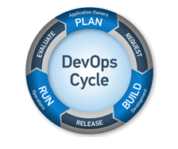
Why ITIL need DevOps:
Collaborative working
Continuous and fast deployment rates
Faster feature delivery
Focus on important work
Environment stability
Service reliability

Slide 8
Why DevOps need ITIL:
Service Design Package and Service Acceptance Criteria
Architectures, plans
Functional support and feedback
Service validation and testing

Slide 9

DevOps + ITIL = increase speed and efficienty of maintaning and service provide or release process, increase quality .

Slide 10
Risks to doing devops:
development and production environments do not support devops tools
we can’t just doing devops because this is a good idea, devops maybe is not good idea in particular situation, it can make things worse
going to add risks to overall proccess
poor vision on end-to-end services
devops need to have relevant data for improvement for making devops decisions
too much focus on tools/automation (only going to make operation faster) DevOps not support things and don’t know what exactly happened.

Slide 11
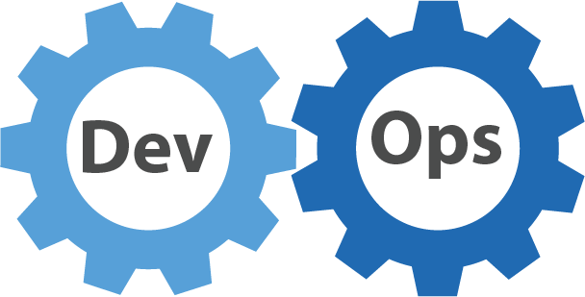
Thank you!

